Slide 1
Reports on Counting of Votes & Declaration of Results and
Post Counting Matters

Slide 2
Statutory Reports

Slide 3
Sl. | Subject | From | Date | To | Mode of Reporting
1. | Form 20 (Final Result Sheet) | R.O. | On C-Day | C.E.O. / D.E.O. | Both the excel file & the signed pdf is to be sent through e-mail and 2 copies, in original, to C.E.O Office through special messenger preferably by the same day and not later than 11.00 am on the next day.
2. | Report of Result of Election [Fax message] | R.O. | On C-Day | E.C.I. / Chief Secretary/ C.E.O. / D.E.O., Secretary General, Lok Sabha, New Delhi, Ministry of Law & Justice (Legislative Deptt.), Govt. of India, Shastri Bhavan, New Delhi | Through FAX and the same may also be sent through email and 2 copies, in original, to C.E.O. Office preferably by the same day and not later than 11.00 am on the next day.

Slide 4
Sl. | Subject | From | Date | To | Mode of Reporting
3. | Form 21C (Declaration of Result under section 66 of R.P. Act, 1951) | R.O. | On C-Day | C.S. / C.E.O./ D.E.O., Secretary General, Lok Sabha, New Delhi | The signed pdf is to be sent through e-mail and 3 copies, in original, to C.E.O Office through special messenger preferably by the same day and not later than 11.00 am on the next day
4. | Form 21E (Return of Election) | R.O. | On C-Day | C.E.O. / D.E.O. | The signed pdf is to be sent through e-mail and 3 copies, in original, to C.E.O Office through special messenger preferably by the same day and not later than 11.00 am on the next day

Slide 5
Sl. | Subject | From | Date | To | Mode of Reporting
5. | Form 22 (Certificate of Election) | R.O. | On C-Day | C.E.O. / D.E.O. | The signed pdf is to be sent through e-mail and 2 copies, in original, to C.E.O Office through special messenger preferably by the same day and not later than 11.00 am on the next day
6. | Certificate of Election – Acknowledgement (Signed by the candidate himself and signature duly attested by the RO) | R.O. | On C-Day | C.E.O./ Secretary General, Lok Sabha, New Delhi | The signed pdf is to be sent through e-mail and 2 copies in original (Attested by R.O), to C.E.O Office through special messenger preferably by the same day and not later than 11.00 am on the next day and another copy, in original, to Secretary General, Lok Sabha, New Delhi (For PC only) by Registered Post with A/D

Slide 6
7. | Secret Seal | R.O. | On C +1 Day | E.C.I. | Within 24 hours after completion of counting to ECI by Registered Insured Post
8. | 02 (Two) unused Ballot Papers for EVM, marked as “Cancelled for Record in the Election Commission”, on its reverse on each, for each Constituency under signature of RO | R.O. | On C +1 Day | C.E.O. | 2 sets in original to C.E.O Office through special messenger preferably by the same day and not later than 11.00 am on the next day

Slide 7
9. | Index Card | R.O. | On C +2 Day | C.E.O | 2 copies in original [in sealed envelope]
10. | Report of the Election by Returning Officer | R.O. | On C +2 Day | C.E.O | 2 copies in original through special messenger

Slide 8
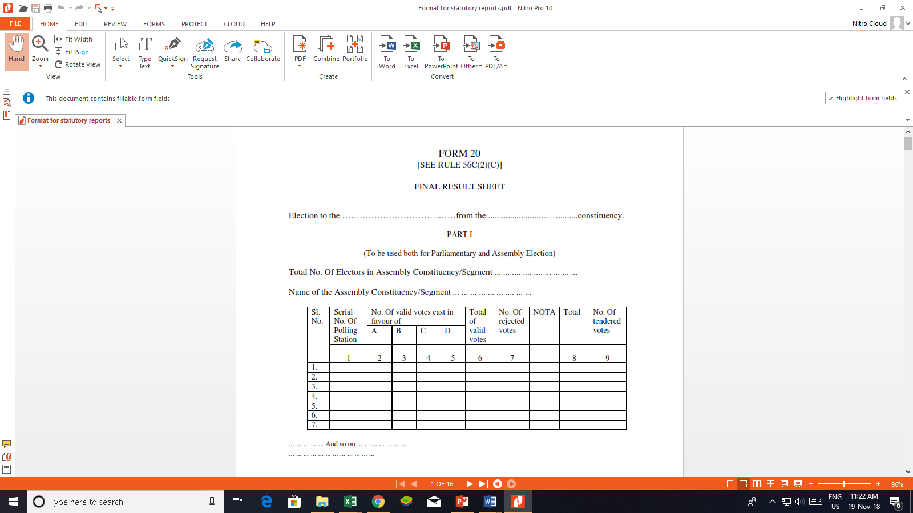

Slide 9
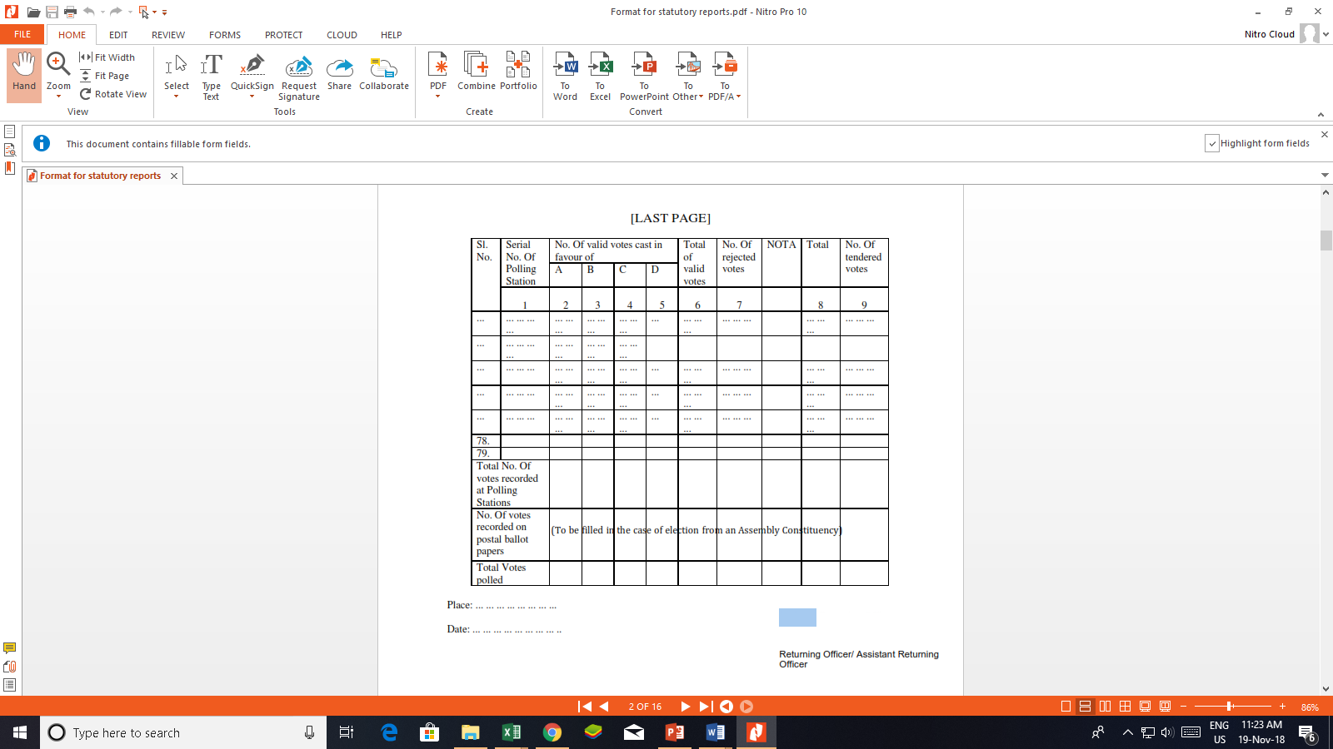
Form 20

Slide 10
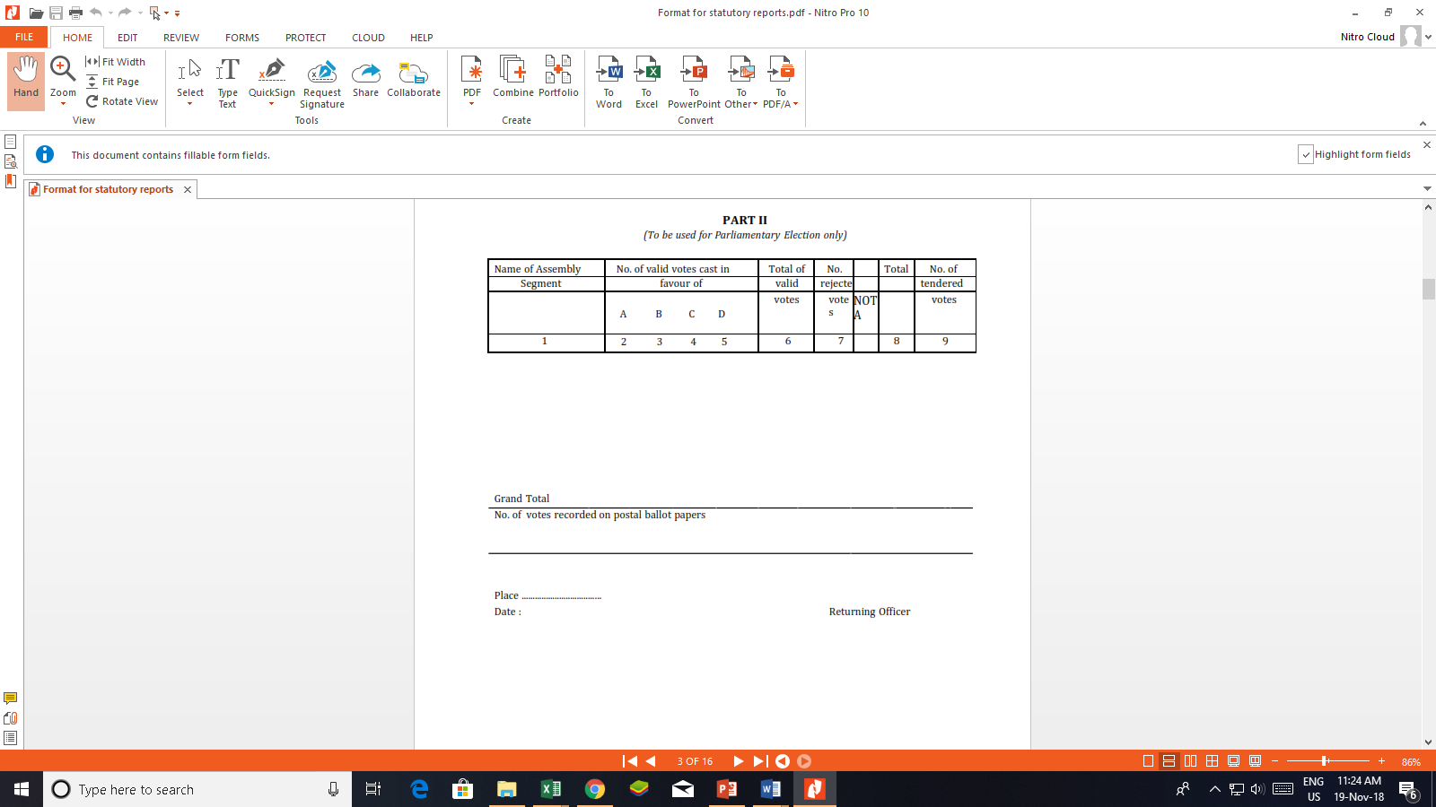

Slide 11
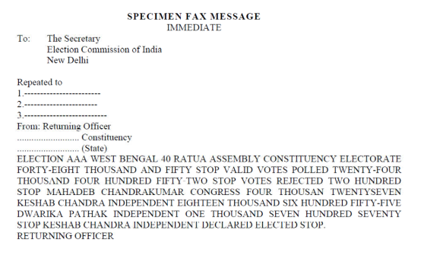

Slide 12
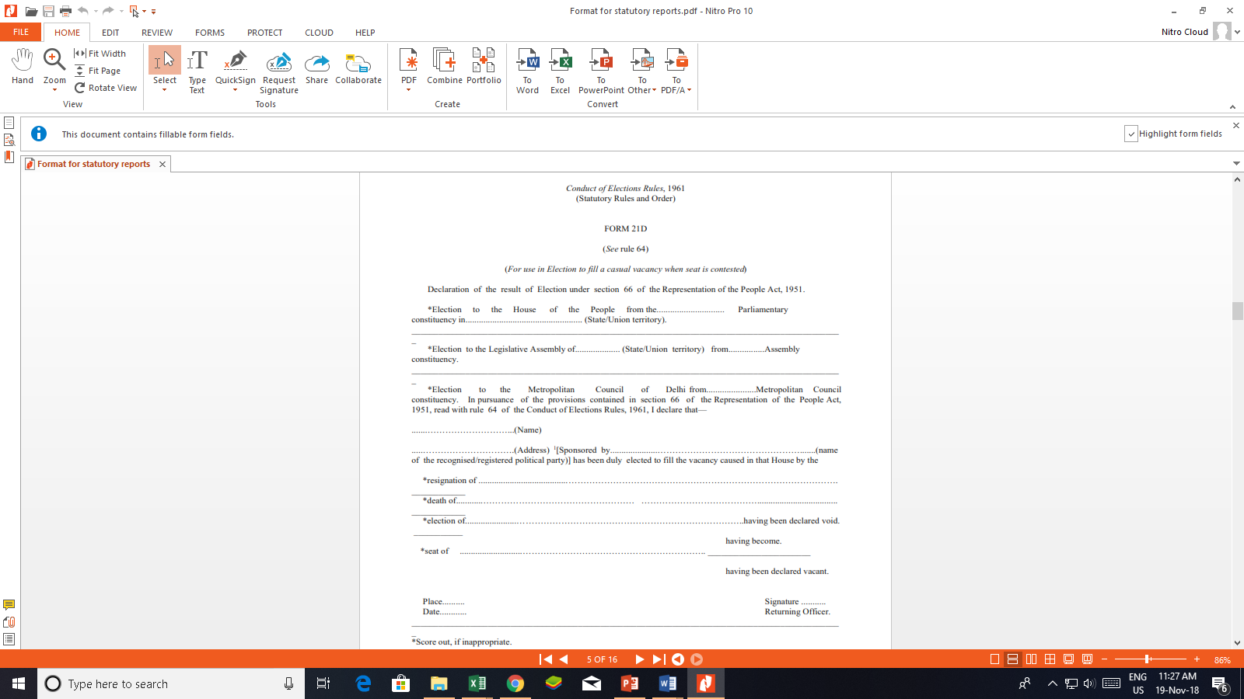

Slide 13
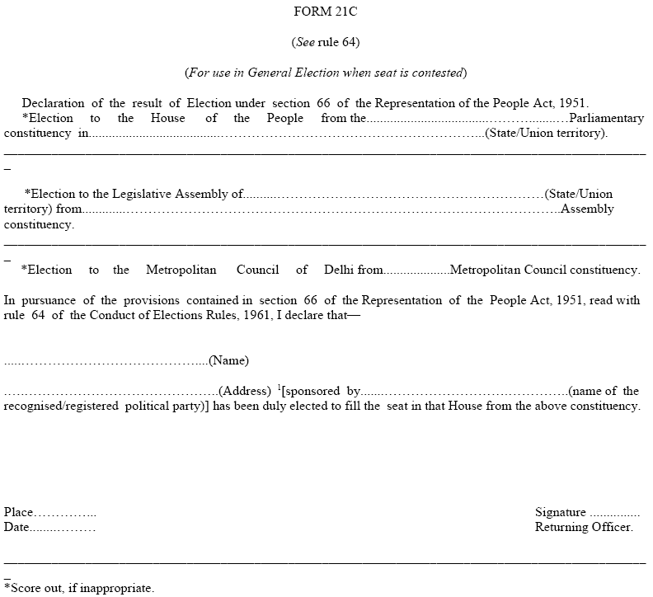

Slide 14

FORM 22 (See rule 66)
Certificate of Election
I, Returning Officer for the……….…...................Parliamentary/Assembly constituency in the State of..................hereby certify that I have on the…..………..........day of
……………………....20…….......declared Shri/Smt……………………………......………………... of.....………….....1[sponsored by...................(name of the recognised/registered political party)] to have been duly elected by the said constituency 2[in the General Election/Bye- election] to be a member of the House of the People/Legislative Assembly and that in token thereof I have granted to him this certificate of election.
Place ......………
Date ......……….
……………………………..............................
Returning Officer, for
the………………….......................Parliament ary
Assembly constituency.
SEAL

Slide 15
ANNEXURE – XIV
CERTIFICATE OF ELECTION
ACKNOWLEDGEMENT
I ................................................................................................................. acknowledge receipt of the certificate of election in Form 22 in respect of my election to
....................................... from ................................... constituency, declared on
..........................................
Date ................................... Signature of the returned candidate
Attested and forwarded to the Secretary
Returning Officer

Slide 16
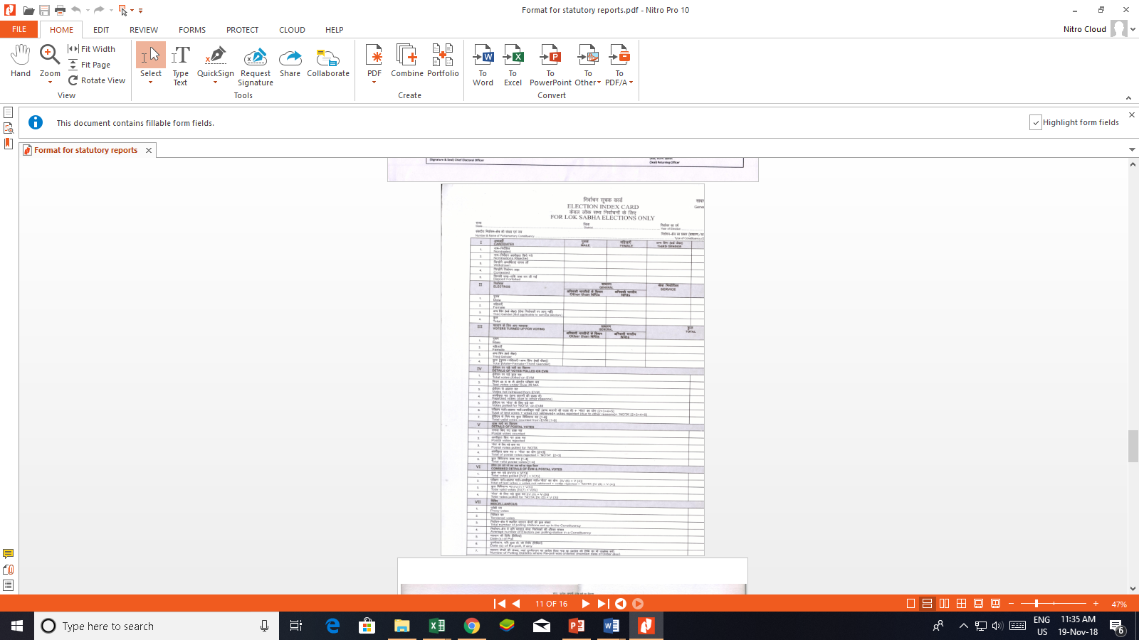

Slide 17
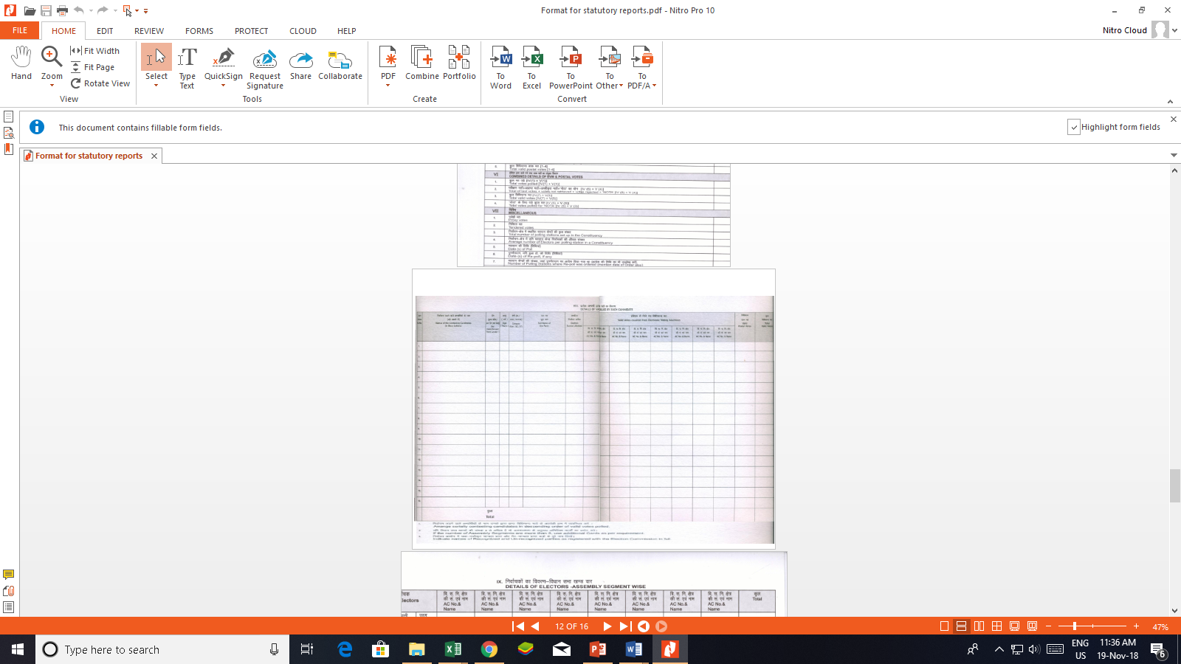

Slide 18
Amendment in Index Card
(Instruction no. No. 485/LET/ECI/FUNC/EDM/1/IC/2018 dt. 22.01.2018)
Some amendment and addition have been made in the Index Cards of Lok Sabha and Assembly Constituency :-
In entry -V Details of Postal Votes, the Postal Votes counted has been segregated into two categories of voters -
Postal votes counted for service voters under sub-section (8) of
Section 20 of R.P.Act. 1950
2. Postal votes counted for Govt. Servants on election duty
(including all police personnel, drivers, conductors, cleaners)
2) In last page of the Index card, an addition has been made between signatures of Chief Electoral Officer and Returning Officer:
1. Date of Press note
2. Date of Gazette notification.

Slide 19
ANNEXURE – XVI
REPORT ON THE ELECTION BY THE RETURNING OFFICER
1 | Name of the Constituency:
2 | Date or dates of poll in the constituency:
3 | Number of the polling parties deployed in the Constituency, the composition of each party including police or similar officers employed for maintaining order at the polling station:
4 | Nature of the polling programme, - Single day poll. Constituency divided into zones and polling completed one after another with one/two days interval for transit or single party took up polling in adjacent polling station on successive 2/3 days of alternative days: ... ... ... ... ... ...
5 | Total number of electors in the Constituency- Men Women Number of electors in the part relating to service voters:
6 | Names of candidates nominated and the choice of symbols expressed by each in the nomination paper first delivered by or on his behalf:
7 | Number of nomination papers filed on behalf of each candidate:
8 | Names of candidates whose nomination papers were rejected with brief reasons:
9 | Names of candidates who withdraw their nominations:

Slide 20
ANNEXURE – XVI
REPORT ON THE ELECTION BY THE RETURNING OFFICER
10 | Names of contesting candidates together with the description of the symbol allotted to each and party affiliation:
11 | Names of candidates who renounced their party after allotment of symbols:
12 | Names of candidates (independents), subsequent to the last date of withdrawal joined some other party, or some other party, or some party claims that its candidate is contesting the elections as a party candidate:
13 | Number of polling station located- (i) In Government and Quasi-Government buildings: (ii) In private buildings: (iii) In temporary structures Total:
14 | Number of postal ballot paper(S)- ... ... ... ... ... ... ... ... ... ... Issued .. ..... ... ... ... .. ... ... ... .. ... .. ... ... Returned back ... .. ... ... ... ... ... ... ... ... .. ... .. Undelivered in time after prescribed hour: ... ... ... ... ... ... ...
15 | 1-Service voters and their wives: 2-Voters on Election Duty: 3-Special voters and their wives: 4-Electors subjected to preventive detention: Date of issue of Postal Ballot Papers to service voters:

Slide 21
ANNEXURE – XVI
REPORT ON THE ELECTION BY THE RETURNING OFFICER
16 | CSVs and Proxy Voters (a) Total number of CSVs: (b) Number of Proxies who voted:
17 | Names of polling stations, if any, where poll was adjourned and re-poll was ordered and reasons for such adjournment or re-poll:
18 | Number of Ordinary Electors who voted at polling stations:
19 | Number of persons who voted on production of Election Duty Certificate:
20 | Number of blind or infirm voters who voted with the help of companions:
21 | Percentage of votes polled to total electorate:
22 | Date and time of commencement of counting:
23 | Number of valid votes polled by each contesting candidates:
24 | Number of votes rejected: (Postal ballot Papers):
25 | Challenged vote Total: Number allowed: Number rejected: Amount forfeited:
26 | Tendered votes-Total:
27 | Date and time of declaration of result:
28 | Number of Polling Officers recruited locally:
29 | Number of candidates: party wise (also independents and others)

Slide 22
ANNEXURE – XVI
REPORT ON THE ELECTION BY THE RETURNING OFFICER
30 | (a) Forfeited deposit: (b) Amount of deposit forfeited:
31 | Number of candidates who were their own election agents:
32 | Number of election agents appointed:
33 | Number of polling agents appointed:
34 | Number of candidates who appointed polling agents:
35 | Number of counting agents appointed by candidates:
36 | Number of voting machines used: (i) Number of Control Units: (ii) Number of Balloting Units: (iii) Number of Voting Machines kept in reserve stock: (a) Number of Control Units: (b) Number of Balloting Units: (iv) Whether any machine from the reserve stock was used: if so, how many control units and how many balloting units:
37 | Number of paper seals used:
38 | Number of indelible ink phials supplied to each polling party:
39 | Number of Electoral Offences with their details – Number of cases of – (a) Disorderly conduct at election meetings (b) Convening, holding or attending public meetings within the constituency on a polling day: (c) Illegal hiring or procuring of conveyances for the transport of voters (d) Canvassing within one hundred meters of a polling station (e) Impersonation of voters (f) Fraudulent defacing, destroying or removal of a list or notice or other document at a polling station (g) Bribing of voters (h) Intimidation of voters (and other persons) (i) Booth capturing

Slide 23
ANNEXURE – XVI
REPORT ON THE ELECTION BY THE RETURNING OFFICER
40 | Mistakes and irregularities committed by Presiding Officers
41 | Highest and lowest polling – polling station wise
42 | (a) No. Of votes cast- from 07.00 a.m. to 09.00 am From 09.00 a.m. to 11.00 a.m. From 11.00 a.m. to 01.00 p.m. From 01.00 p.m. to 03.00 p.m. From 03.00 p.m. to 05.00 p.m. (b) Number of slips issued at the closing hour of the poll:
43 | Serious Complaints, if any, made by the candidates
44 | Number of cases of breach of law and order
45 | Recounting of votes- (j) Number of application received for recounting in part or in toto: (k) Number of applications allowed for recounting in part or in toto: (l) Result before recounting and after recounting of votes:
46 | Was the poll interrupted or obstructed by: (1) Riot (2) Open violence (3) Natural calamity (4) Failure of voting machine (5) Any other cause –Please give details of the above
47 | Was the poll vitiated by – (1) Any ballot box used at the polling station having been unlawfully taken out of the custody of the Presiding Officer – Accidentally or intentionally destroyed or lost: Damaged or tampered with: (2) Booth capturing:
48 | Whether declarations have been made by all the Presiding Officers before the commencement of the poll and at the end of poll as necessary:

Slide 24
Non-Statutory Reports

Slide 25
Sl. No. | Subject | From | Date | To | Mode of Reporting
1. | Certificate confirming the readiness of Counting Centre including every counting hall (Annexure – 1A & 1B) | D.E.O. | On C-3 day | C.E.O. | The signed pdf is to be sent through e-mail
2. | Confirmation Report on sending notice to Candidates or their Election Agent regarding the date, time and place of counting (Annexure – 2) | R.O. | On C-3 day | C.E.O. / D.E.O. | The signed pdf is to be sent through e-mail
3. | Commencement of counting (Annexure – 3) | D.E.O. | On C - day by 08.15 A.M. | C.E.O. | The signed pdf is to be sent through e-mail

Slide 26
Sl. No. | Subject | From | Date | To | Mode of Reporting
4. | Tabulating Trends / Result (As per Annexure – I, Commission’s letter no. 470 / INST / 2014 – EPS dated 30.04.2014) | R.O. | On C-day From 09.00 A.M. (Round- wise) | C.E.O. / D.E.O. | The round-wise signed pdf is to be sent through e-mail
5. | Malfunctioning of EVM (Relevant Annexures – as per Manual of EVM-VVPAT) | R.O. | (immediately, if situation arises) | E.C.I. / C.E.O./ D.E.O | The signed pdf is to be sent through e-mail/ fax

Slide 27
Sl. No. | Subject | From | Date | To | Mode of Reporting
6. | Counting of Printed Paper Slips of VVPATs in case of non-retrieval of result from the Control Unit (Commission’s letter No. 51/8/VVPAT/2017-EMS dt. 20.12.2017) | R.O. | (immediately, if situation arises) | E.C.I. / C.E.O./ D.E.O | The signed pdf is to be sent through e-mail/ fax
7. | Report on electors deciding not to vote as per Accounts of Votes recorded (Form – 17C) [Annexure – 4] | R.O. | On C-day | C.E.O. / D.E.O. | Both the excel file & the signed pdf is to be sent through e-mail

Slide 34
Post Counting Matters

Slide 35
STORAGE OF EVMs & VVPATs AFTER COUNTING OF VOTES
After completion of counting of votes, EVMs and VVPATs containing printed paper slips in its Drop box, shall be kept in the same strong room without removing Power Packs of Control Units and Power Packs , Paper Rolls and Ballot Slips of VVPATs.
The Strong room shall not be opened till completion of Election Petition (EP) period i.e. till EP list is received from respective High Court.
After completion of Election Petition Period, the exact EP position should be ascertained from High Court concerned before opening the strong room.

Slide 36
Safe custody of election records / EVM-VVPATs after result
Under double lock - one key with DEO and one with Dy. DEO
Disposal of record - After expiry of prescribed period

Slide 37
Disposal of deposits made by candidates (Sec. 158)
The deposit can be refunded only to the person in whose favour it was made in the treasury or his legal representatives if he is dead.
The deposit shall be refunded if the conditions laid down u/s 158 of RP Act, 1951 are fulfilled.
Form of applications for return is given in RO Hand book.

Slide 38
Disposal of surplus and waste ballot papers
Directions of Commission given at Para 13 of Ch. XVIII of RO Hand book shall be followed strictly.
Superintendent Government Press and Collector / District Magistrate of the district, wherein Govt. Press is situated, shall send a report within a week to the CEO certifying that all surplus and waste ballot papers printed have been destroyed in the prescribed manner. Such consolidated report with certificate shall be submitted onwards to the Commission by the CEO.

Slide 39
Period of retention of the Affidavits in Form 26 and the Nomination papers filed by the candidates.
(ECI instruction No 3/ER/ECI/LET/FUNC/JUD/SDR/2016 dated 18th August, 2016)
Nomination Papers and Affidavit (Form 26)- To retain for a period of 06 (six) years after the completion of elections or till disposal of election petition, if any, or any other suit/petition in any court in which any of the declarations made in any of these documents is under challenge.
All the supporting documents filed by the candidates along with their nomination papers shall also be likewise retained for the same period.

Slide 40
Storage and Supply of CCTV Recordings
(ECI instruction No. 3/ER/ECI/LET/FUNC/JUD/SDR/2016-EPS Dated 7th September 2016)
Videography/CCTV footage of various stages of election process like nomination, scrutiny, withdrawal, polling and counting process etc. should be kept in the safe custody of the District election Officer till the expiry of 45 days from the date of declaration of result of the election.
If anyone applies for copies of such recordings, during the said period of 45 days, copy may be made available to him on payment of Rs. 50/- per CD (fees as per Right to Information Rules, 2012).

Slide 41
Storage and Supply of CCTV Recordings
(ECI instruction No. 3/ER/ECI/LET/FUNC/JUD/SDR/2016-EPS Dated 7th September 2016)
The video recordings of election campaign activities of candidates and political parties made by the election expenditure monitoring teams, flying squads, SSTs etc. the recorded version there of shall be kept in the custody of District Election Officer till the expiry of 8 months from the date of the declaration of result of the election.

Slide 42
If anyone applies for copies of such recordings, during the said period, copy may be made available to him on payment of Rs. 50/- per CD
In case no election petition or any other petition etc. is pending, the CCCTV/Video recording should be destroyed after expiry of the prescribed period, following the usual procedure prescribed for the purpose.
If there is an election petition filed in respect of the election or any other petition etc. in any court in respect of which the recording would be relevant, then the recorded version shall be retained in safe custody of DEO till the disposal of such matter.

Slide 43
LODGING OF ACCOUNTS OF ELECTION EXPENSES:
Candidates are required to lodge their accounts of election expenses with the DEO within 30 days of declaration of result along with the register of election expenses (U/s. 78 of the RP Act,1951)
As soon as the accounts are received, the Abstract Statement needed to be scanned and uploaded in the website of the CEO within 3 days of receipt by DEOs for dissemination among public.
If any discrepancy/ies in any item of expenditure is noticed vis-à-vis SOR/FE after receipt of accounts and if no notice was issued earlier, DEO shall, with the assistance of AEO, issue notice to the concerned Candidate within 2days of receipt of accounts and ask the candidate to submit his/her reply within 3days of service of notice.

Slide 44
Declaration on Criminal Cases ( Ref : ECI order dt 10.10.2018)
Those candidates who having criminal cases against them, shall submit the copies of newspapers in which the declaration on criminal cases was published to the District Election Officers, along with the Election expenses.

Slide 45
Thank You

